Slide 1
Aim & Scope
Aim
Develop an educational game for children about the concept of saving electricity for Android.
Scope:
4-6 year old children target
2D style Game
Unity Game Development

Slide 2
Idea
Quiz like game with audio instead of texts
Level progression
2D Style
Some animation

Slide 3
Literature Analysis
Save the Power
Defenders of Nature
Nature Warrior
Save Water
Protect the Tree
Garden Game
Jungle Doctor
Save Water & Earth

Slide 4
Literature Comparison Table

Slide 5
Popular Games
Garden Game for Kids
Pros:
Good visuals
Animation support for children
Multiple learning outcomes
Cons:
Difficult to tilt water pot and seed bag
Jungle Doctor
Pros:
Good Visuals and theme
Different animals used to gain attention
Cons:
Healing process takes time
Not enough animation support

Slide 6
Literature Review Conclusion
What we liked and want to implement:
Visual art theme for children
Animations
Simple Interface
What we did differently:
Voice audio
Target 4-6 years old

Slide 7
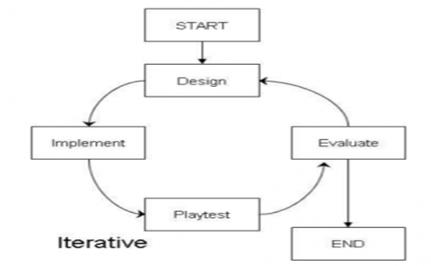
Methodology: SDLC Spiral Model

Slide 8
Game Menu

Slide 9
LEVEL START

Slide 10
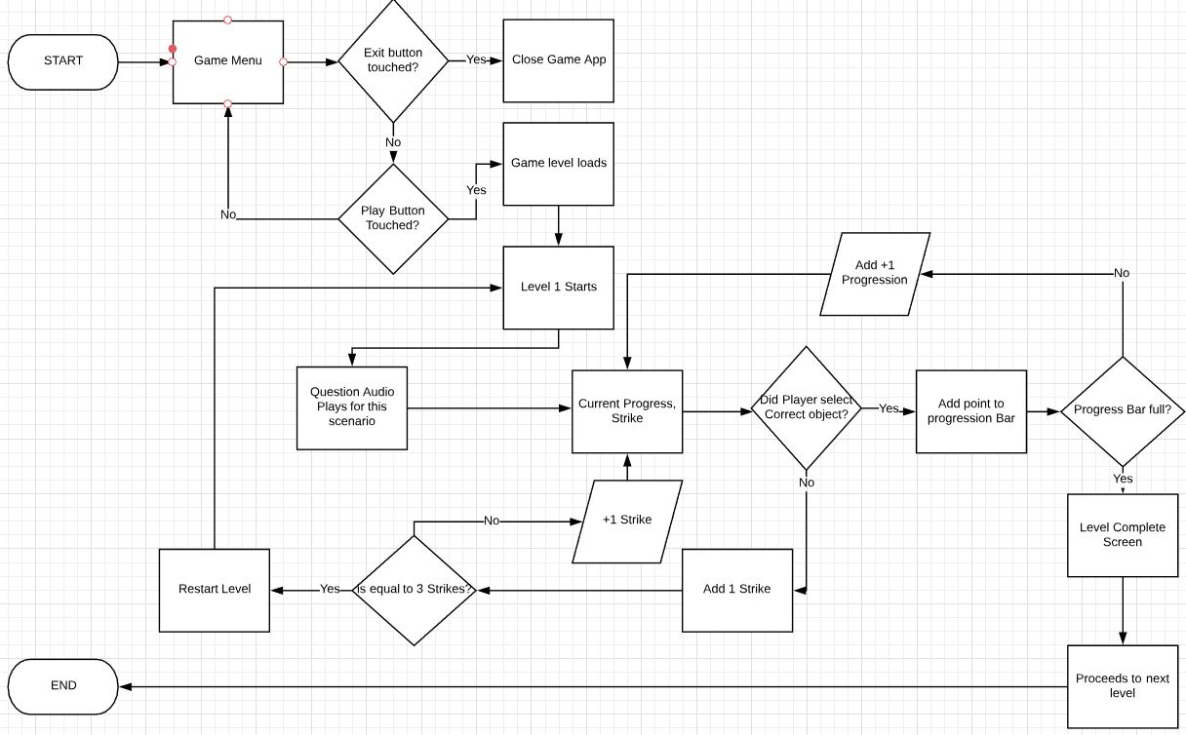
Flowchart

Slide 11
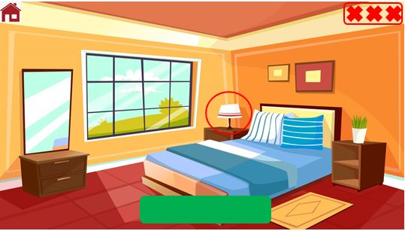
Example

Slide 12
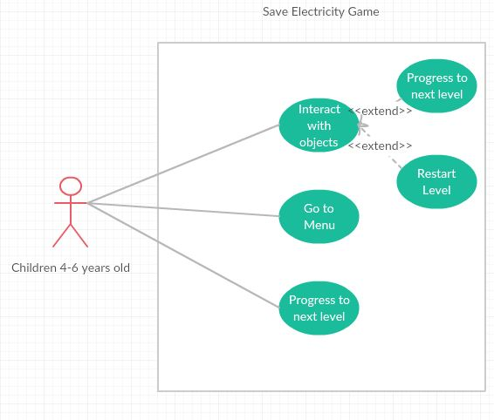
Use Case

Slide 13
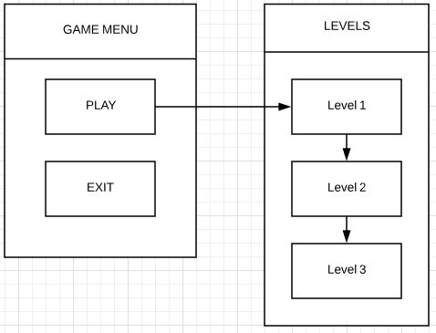
Overall Navigation

Slide 14
Resources
Software:
Unity
Visual Studio
Photoshop
Hardware:
PC desktop
Android device

Slide 15
Project Risks
Lack of game developing experience
Dependent on assets
Time constraint

Slide 16
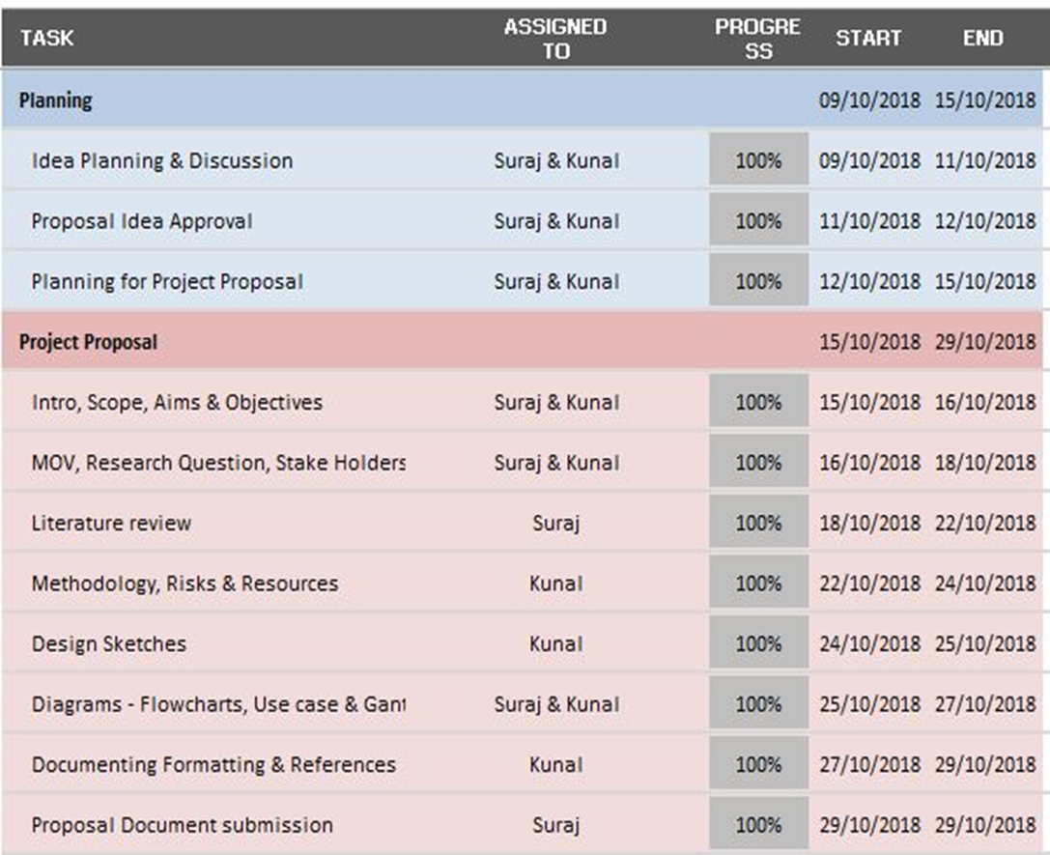
Our Progress

